Slide 1


SAP OData Training
Day - 6.

Slide 2


Agenda Day - 6
Image Processing
What is Fiori ?
Basic’s of Fiori
How to Setup BAS
Installation of VS Code
Create Destination
Break
Build Fiori App using Template Approach
Final Fiori App
Trainer: Anubhav Oberoy & Shubham Singh

Slide 3
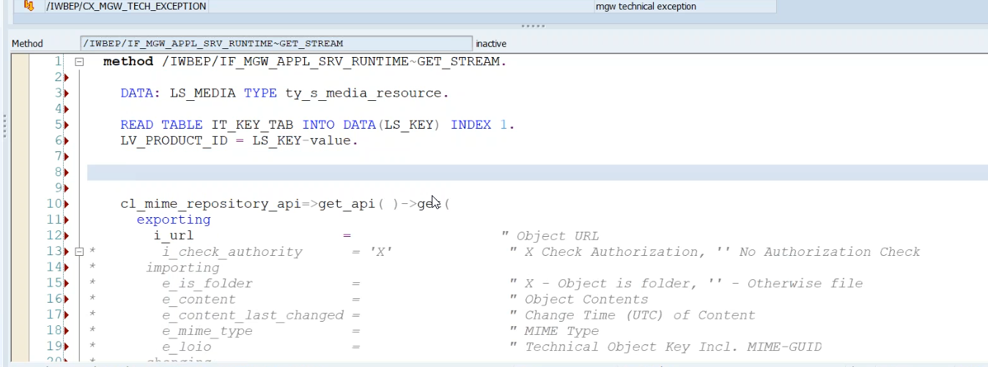
Image Processing
In ABAP all images are store in MIME Repository. To see MIME Repository
go to se80 > utilities > settings > MIME Repository
to add Image in OData
Step1: Go to service > entity Type > Create Copy of Product >select the media check box
Step2: Now add two new property to Product Set
- Product_pic_url
- MIME_TYPE
Step3: Go To MPC Extension Class and redefine the DEFINE method(for code ClickHere)
Step4: Go to DPC Extension class and redefine the Method Get_Stream (for code ClickHere)
Introduction
01
02
Trainer: Anubhav Oberoy & Shubham Singh

Slide 4
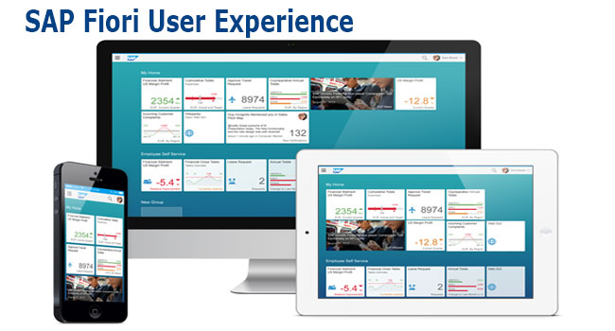
What is Fiori ?
Fiori is SAP’s new user experience. These are standard apps delivered by SAP and by following the Development guidelines any one can use UI5 to create fiori Apps.
Fiori is a streamlined application, delivering a role-based user experience that can be personalized across all lines of business, tasks and devices.
It uses tiles to encapsulate standard tasks like viewing sales orders or approving timesheets.
Fiori = UI5 + Development/Design Guidelines
Introduction
01
Software Innovation
02
Trainer: Anubhav Oberoy & Shubham Singh

Slide 5
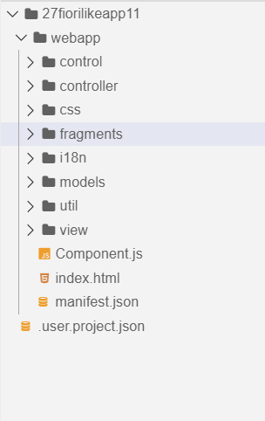
Basic’s of Fiori
There are different folders and directory are required for setup project
Webapp = This provides the root directory and of all files given in alias name or namespace
Controller = The controller folder contains all the controllers used by your views, and might also contain additional logic files that are used by one or more controllers. The structure of the controller folder should mirror the view folder.
models = It contains .json file and object of data
utils = It is the reuse file of JS code
view = It contains all the .xml files.
Component.js = It is the starting file of our app
manifest.json = It is the application descriptor file.
Index.html
Introduction
01
Software Innovation
02
Trainer: Anubhav Oberoy & Shubham Singh

Slide 6
Setup BAS (Business Application Studio )
Click on GO
Create free trial account
Introduction
Launch your cloud platform
trial cockpit - Click
BAS SETUP
01
Software Innovation
On main screen you will see BAS
Click and Create Dev Space &
choose Fiori as Dev Space Type
02
Hardware Innovation
Trainer: Anubhav Oberoy & Shubham Singh

Slide 7
Installation of VS Code
VS code a open source development tool (IDE) by Microsoft for developer community. Billions of developers across industry use this tool for all kinds of development (web, android, erp apps, fiori). Hence SAP also recommend to follow industry best practice. The BAS is a copy of VS Code (local BAS). If you adopt VS Code, you don’t need to buy SAP BAS subscription so it’s a cost saving for company.
Pre-requisites
Node JS to be installed (min v10) – node –v
Download and install node js from here
We need to install SAP UI5 tooling used by Node JS (support module to work with ui5 apps)
– npm install –g @ui5/cli
Steps to install VS Code
Download and install VS Code for free from here
Open the VS Code
Add A folder C:\UI5 Project\basics ← project name
Create webapp/index.html file and same content like WebIDE
Run following command by opening terminal in VS Code and go inside project directory
npm init
ui5 init
6. Inside the webapp folder, create a file manifest.json
7. Start web server using command ui5 serve
Introduction
01
Software Innovation
02
Hardware Innovation
Trainer: Anubhav Oberoy & Shubham Singh

Slide 8

Connectivity: Role of SCC
Internet
Intranet
SAP BW
SAP ECC
SAP S/4 Hana
SAP BTP (PublicCloud)
SAP On-premise System
SAP Business Application Studio
Introduction
SCC
Destination
01
Software Innovation
S/4 Hana Cloud
Field Glass
Sales Force
02
Hardware Innovation
Trainer: Anubhav Oberoy & Shubham Singh

Slide 9
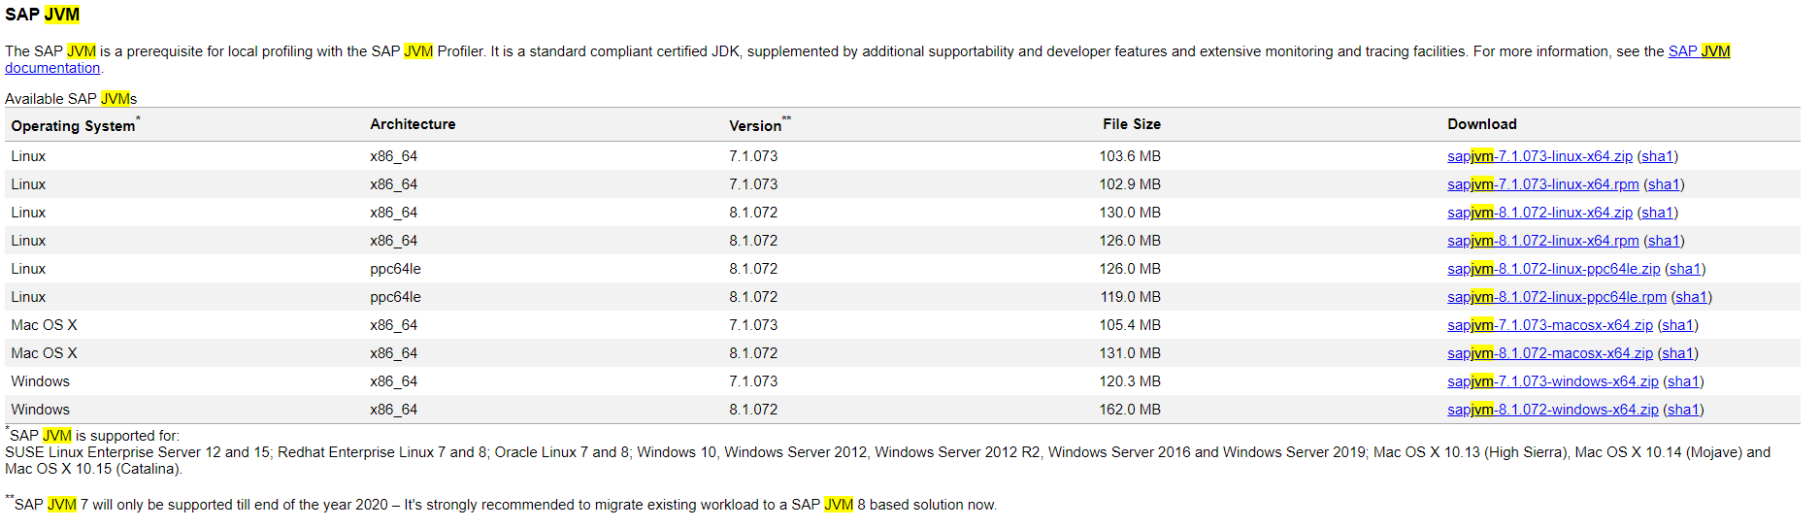
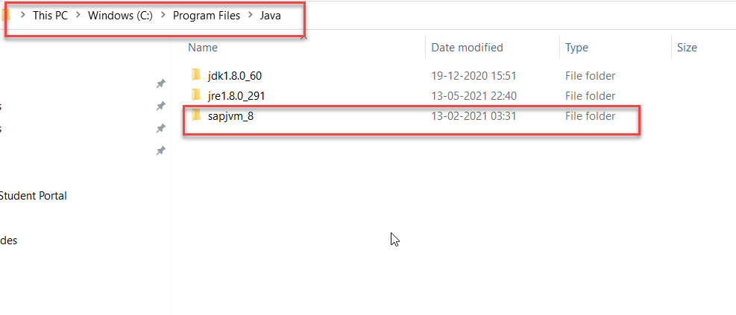
Connectivity
Step1: Download SAP JVM and Extract it in the C:\Program Files\Java
Introduction
01
02
Trainer: Anubhav Oberoy & Shubham Singh

Slide 10
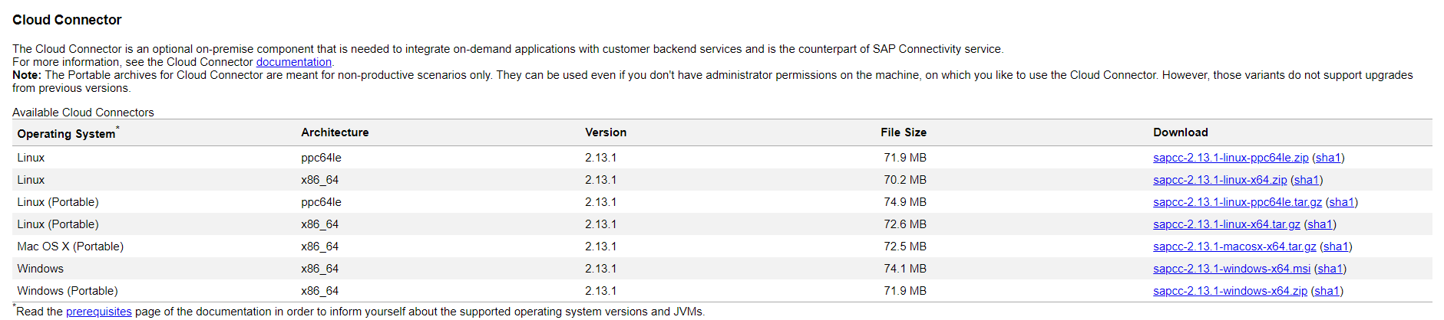
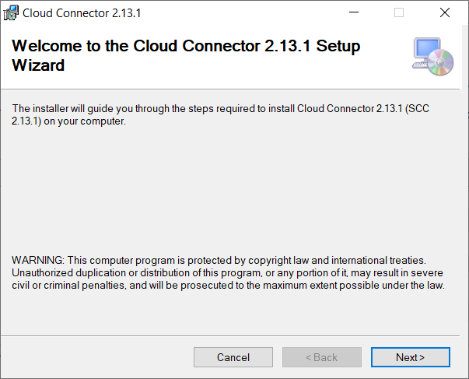
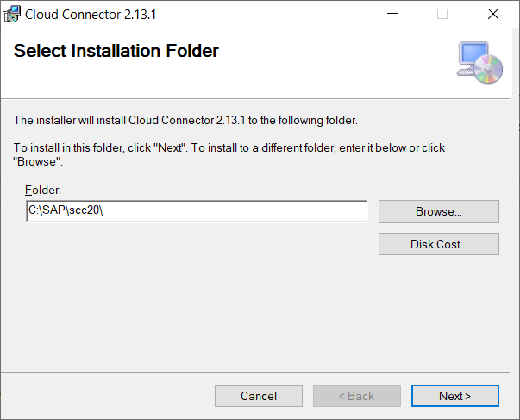
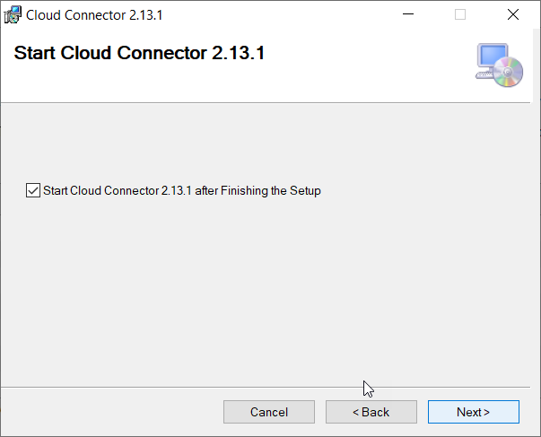
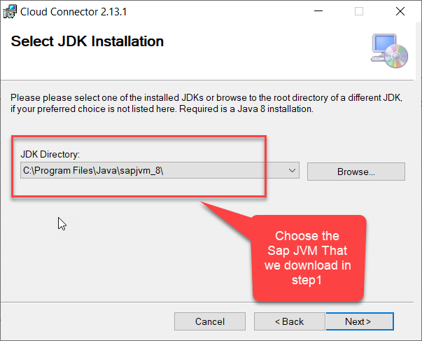
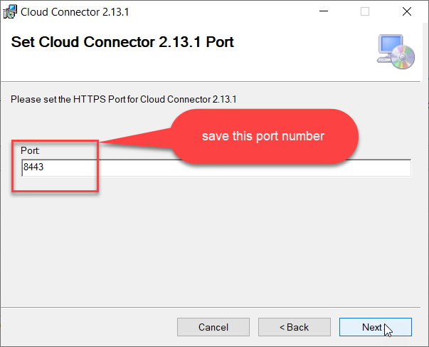
Connectivity
Step2: Download and install the sap Cloud connector
Introduction
01
Software Innovation
02
Hardware Innovation
Trainer: Anubhav Oberoy & Shubham Singh

Slide 11
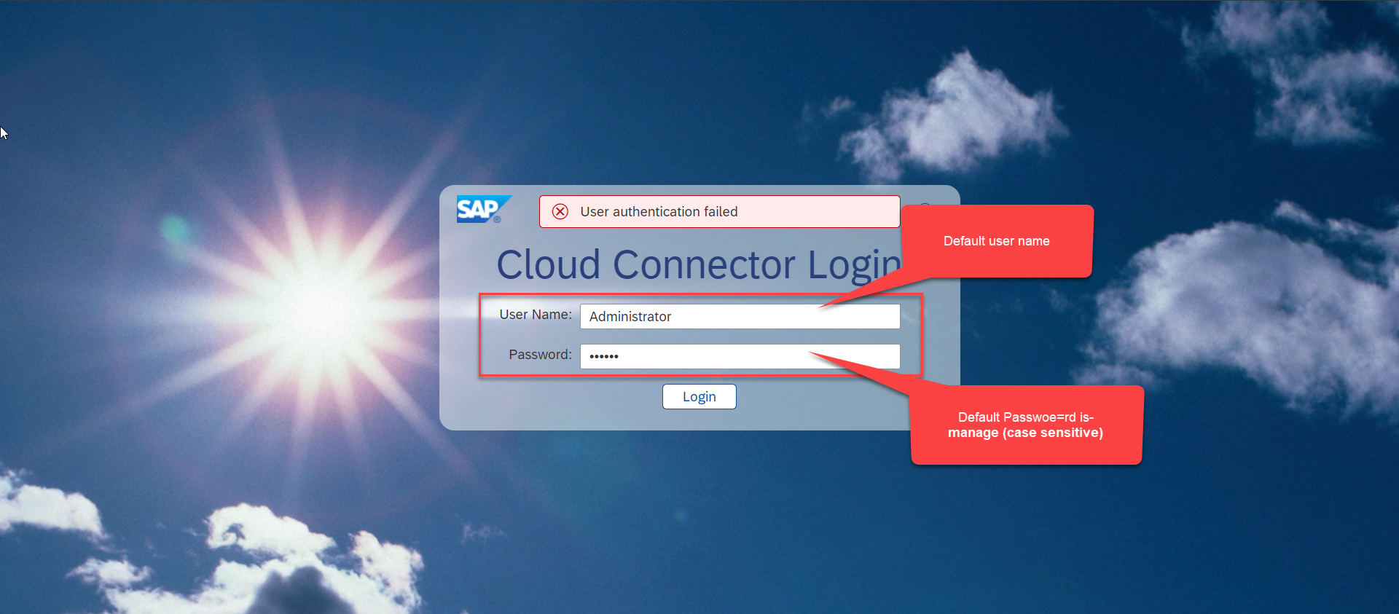
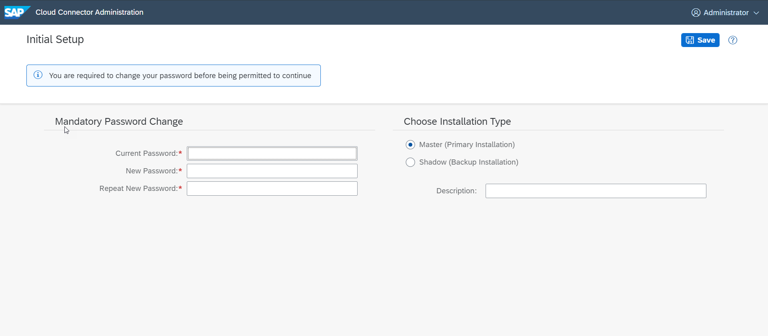
Connectivity
Step3: Now your system is ready go to browser and open https://localhost:8443 (port may changes)
Introduction
01
Software Innovation
02
Trainer: Anubhav Oberoy & Shubham Singh

Slide 12
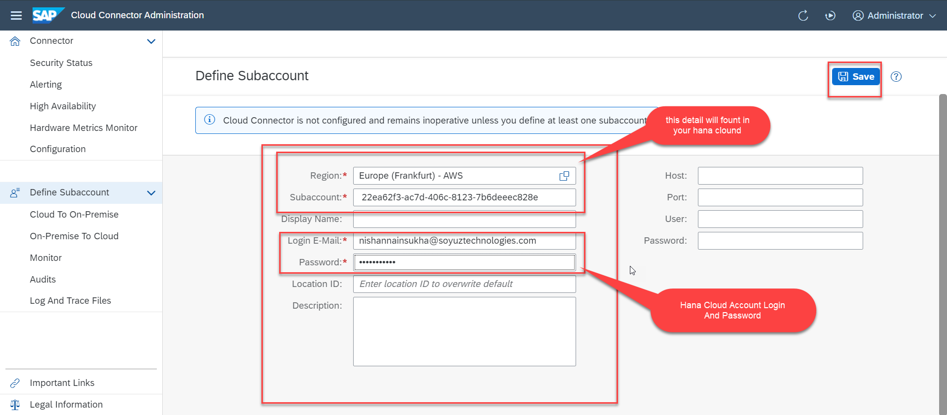
Connectivity
Step4: Now we create a connection with our Cloud Account
Introduction
01
Software Innovation
02
Hardware Innovation
Trainer: Anubhav Oberoy & Shubham Singh

Slide 13
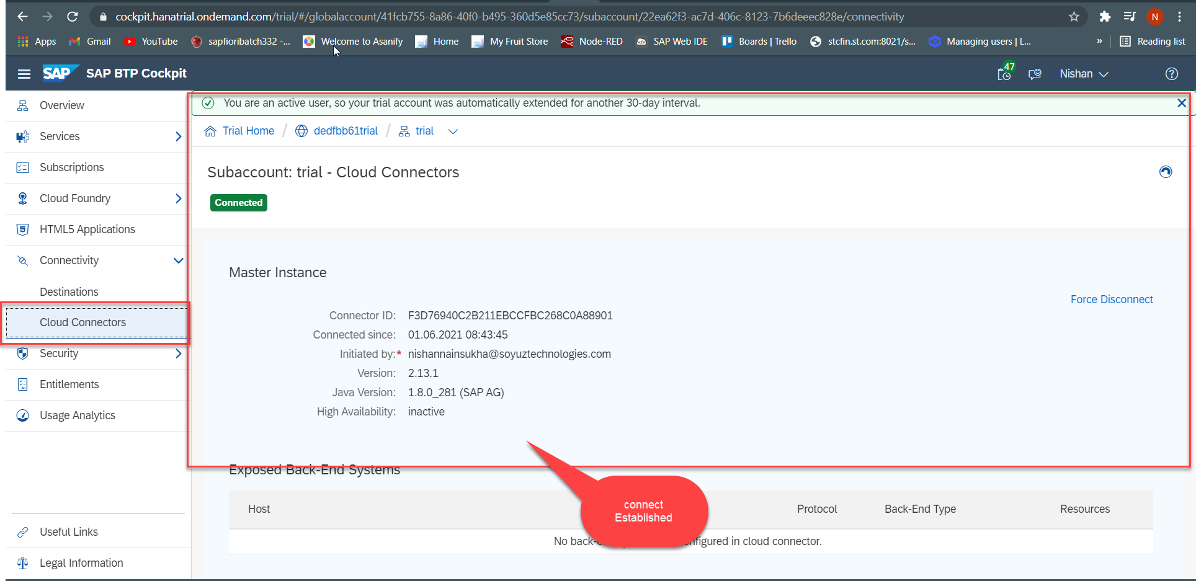
Connectivity
Step5: Check the connection on Hana Cloud Account
Introduction
01
Software Innovation
02
Hardware Innovation
Trainer: Anubhav Oberoy & Shubham Singh

Slide 14
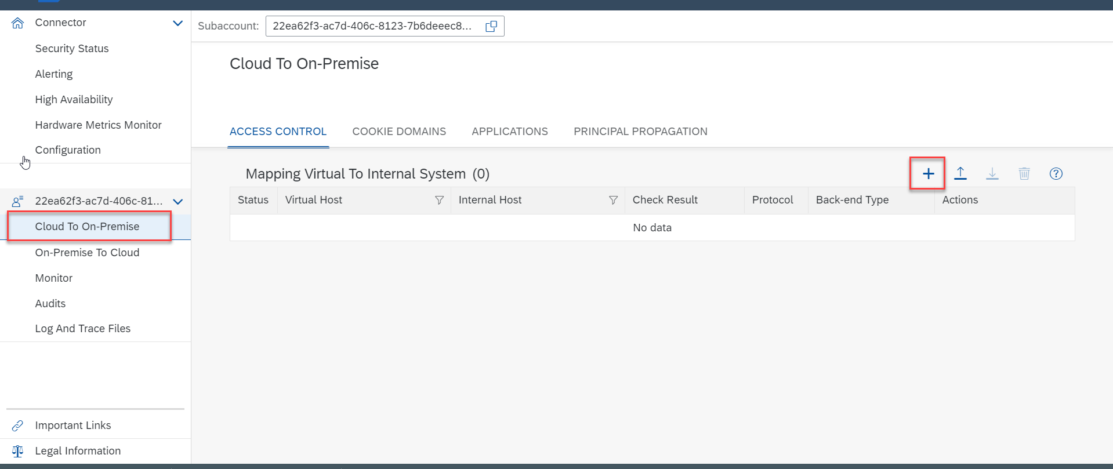
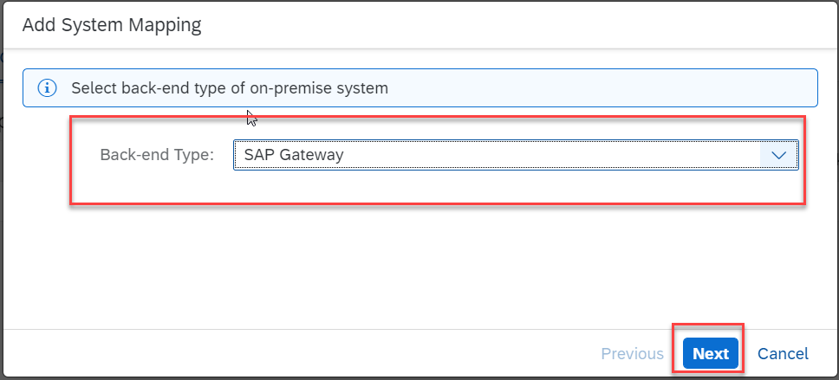
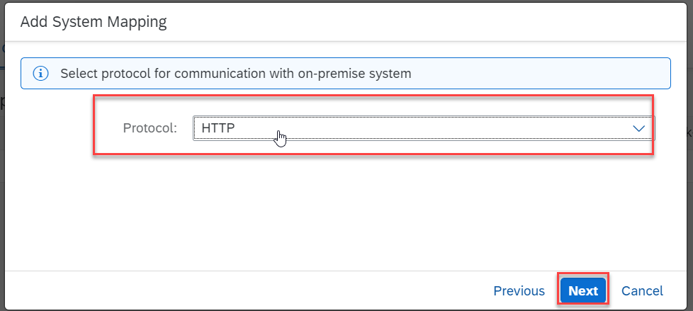
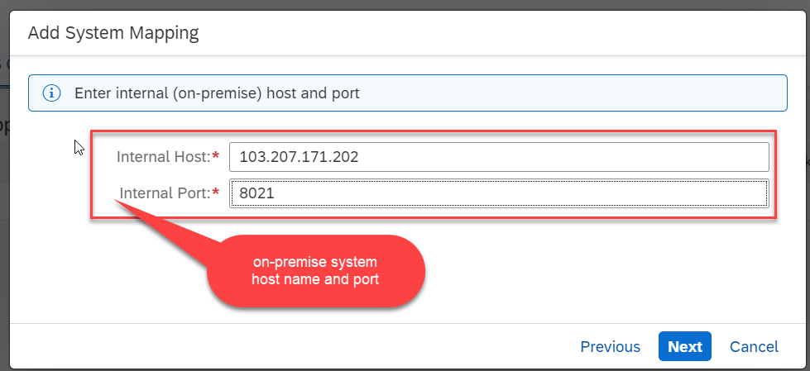
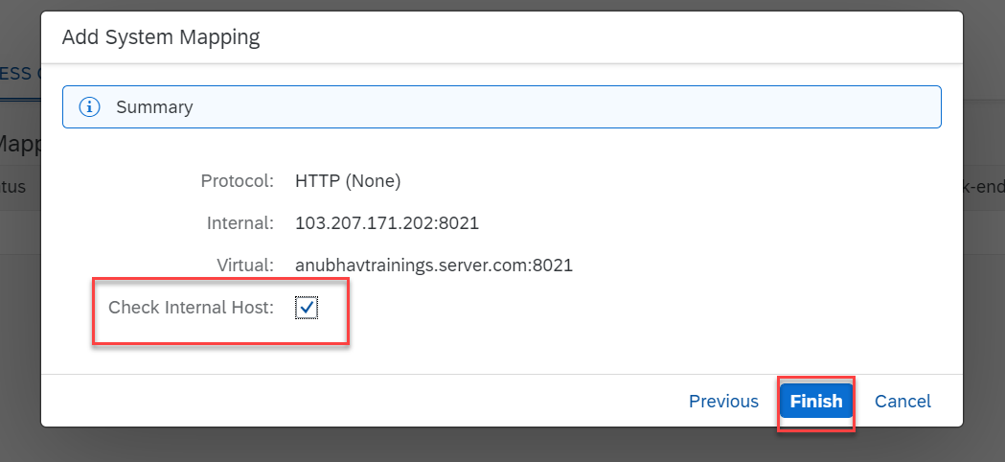
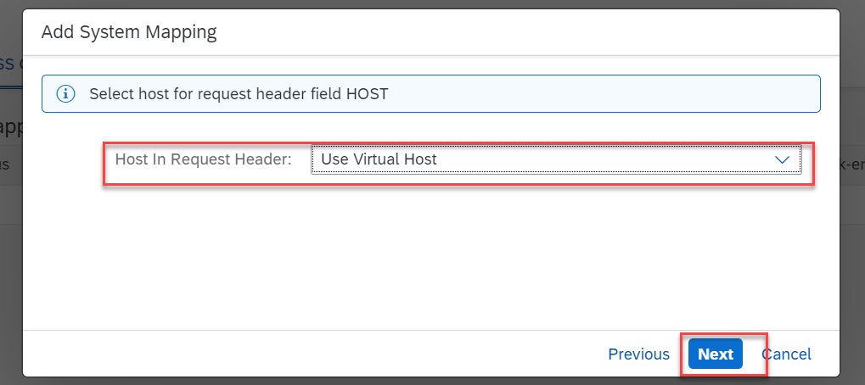
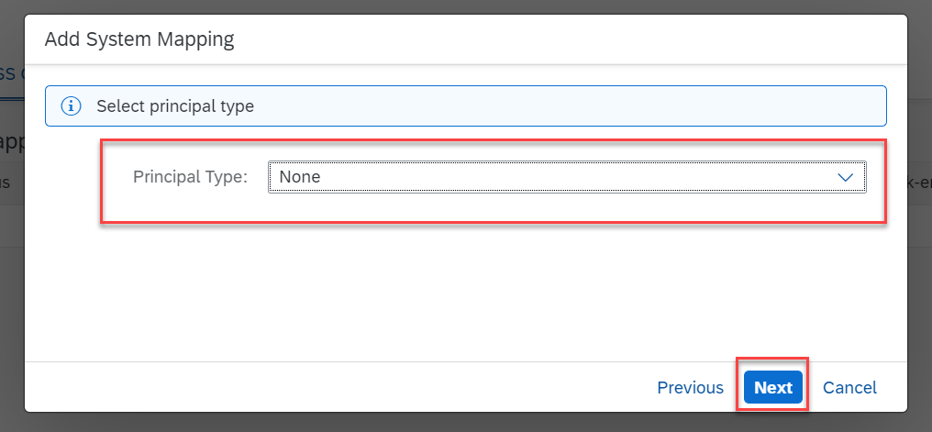
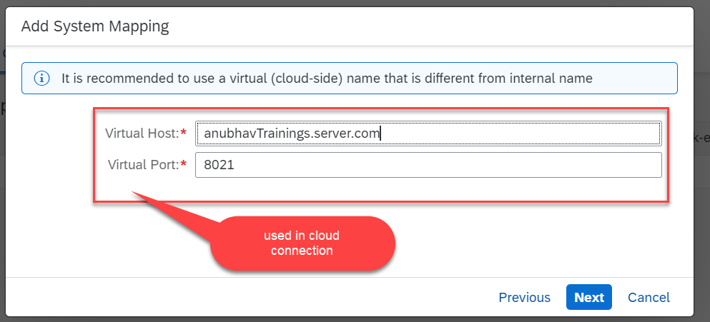
Connectivity
Step6: Connect on-premise system to cloud using SCC
Introduction
01
Software Innovation
02
Hardware Innovation
Trainer: Anubhav Oberoy & Shubham Singh

Slide 15
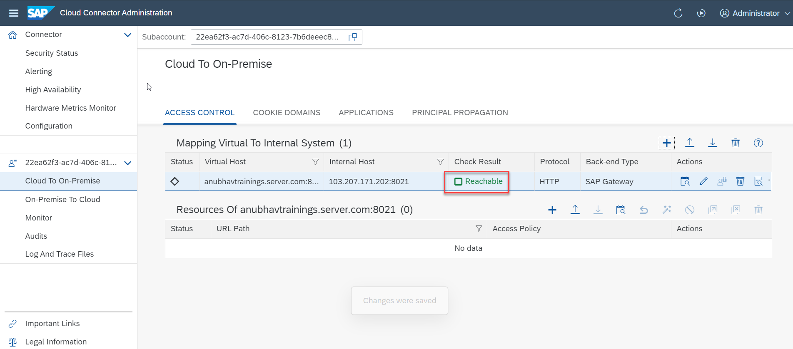
Connectivity
We Done with Connect , now we are connected with cloud using SCC
Introduction
01
Software Innovation
02
Hardware Innovation
Trainer: Anubhav Oberoy & Shubham Singh

Slide 16

Break

Slide 17
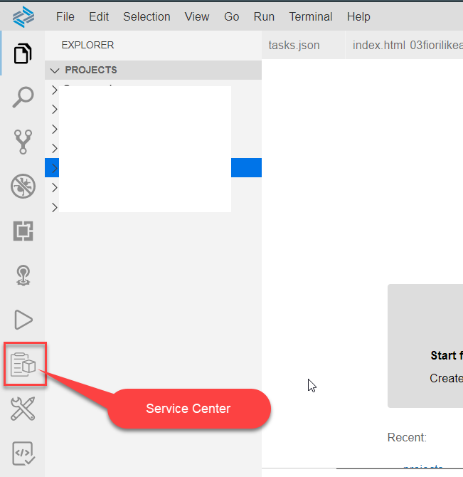
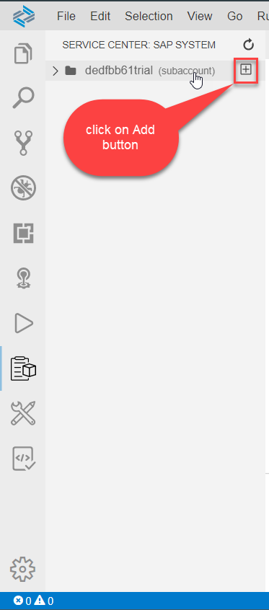
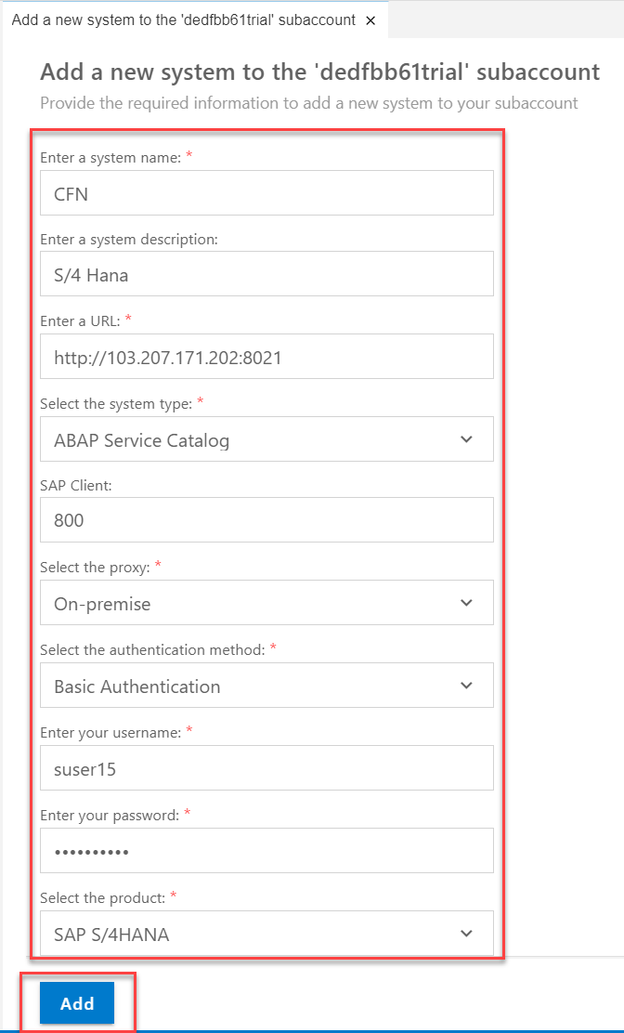
Create Destination
Go to BAS and Click on Service Center Icon in the Left Vertical Menu Bar and click on add
01
Software Innovation
02
Hardware Innovation
Trainer: Anubhav Oberoy & Shubham Singh

Slide 18
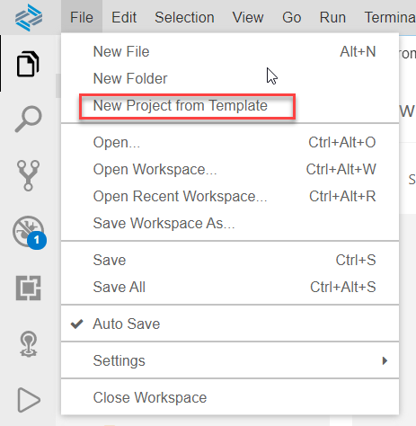
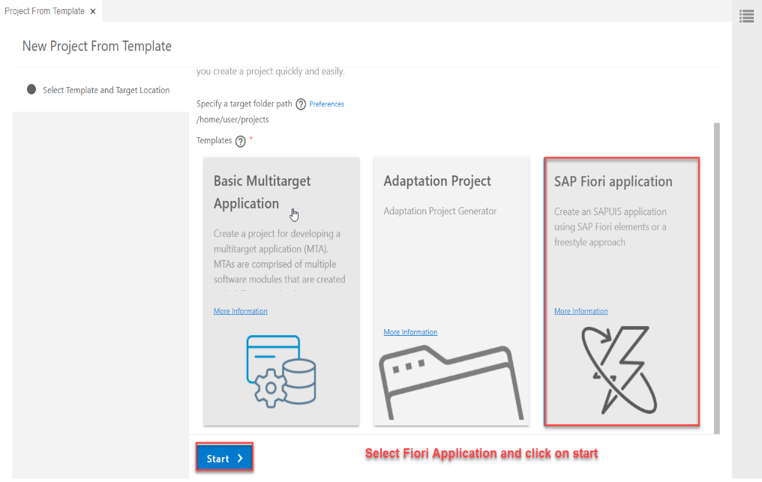
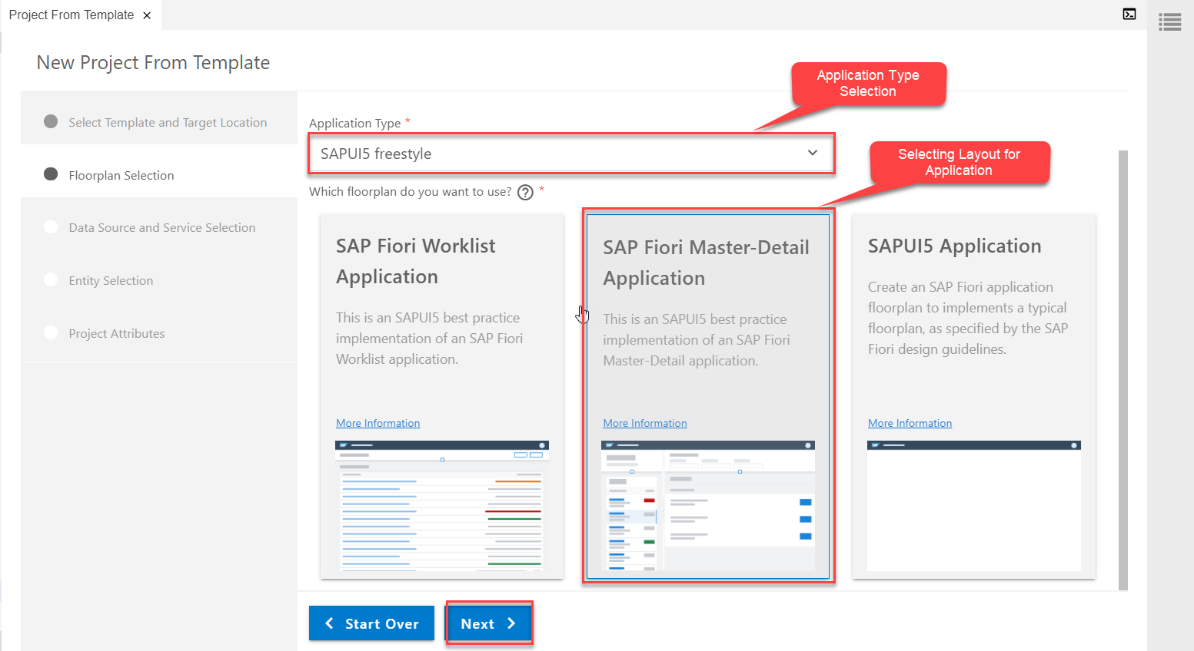
Build Fiori App using Template Approach
Creating a Fiori Application From Template which Consumes Custom OData service
Step1: Starting Project from Template
Introduction
01
Software Innovation
Project From Template
Template Selection (Fiori Application)
Application Type & Layout
Hardware Innovation
Trainer: Anubhav Oberoy & Shubham Singh

Slide 19
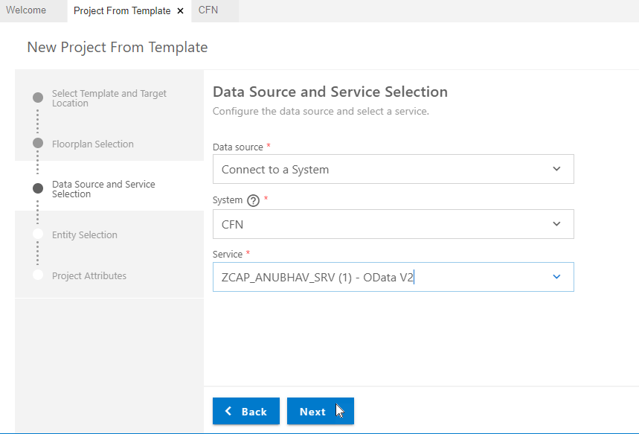
Consuming Custom OData service
Step2: Data Source and Service Selection
service url: http://stcfin.st.com:8021/sap/opu/odata/sap/ZCAP_ANUBHAV_SRV/?$format=json
01
Software Innovation
02
Hardware Innovation
Trainer: Anubhav Oberoy & Shubham Singh

Slide 20
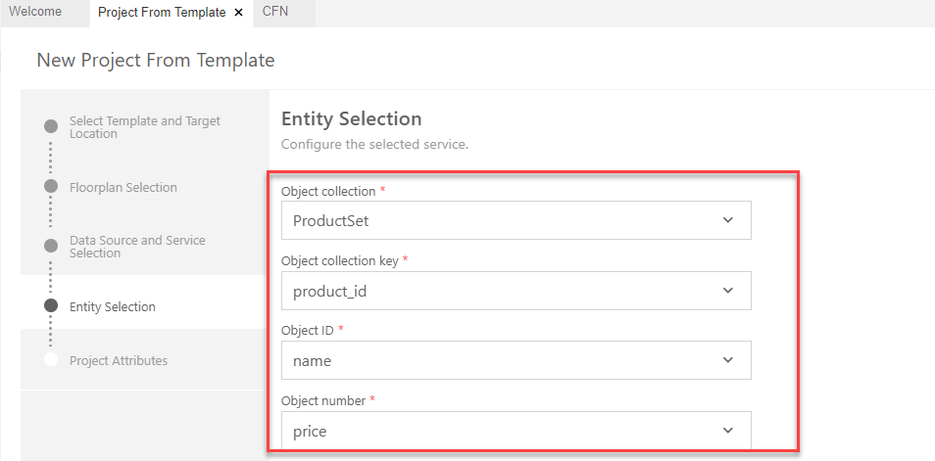
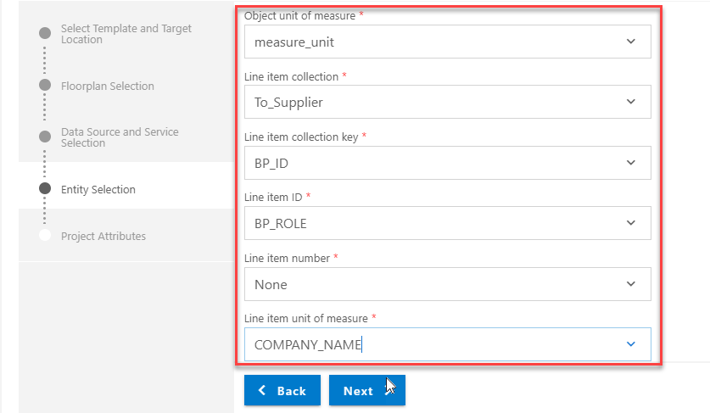
Consuming Custom OData service
Step3: Entity Selection
Introduction
01
3.1 Object Selection(to be viewed in Master Page)
3.2 Line Item Selection (to be viewed in Detail page)
02
Trainer: Anubhav Oberoy & Shubham Singh

Slide 21
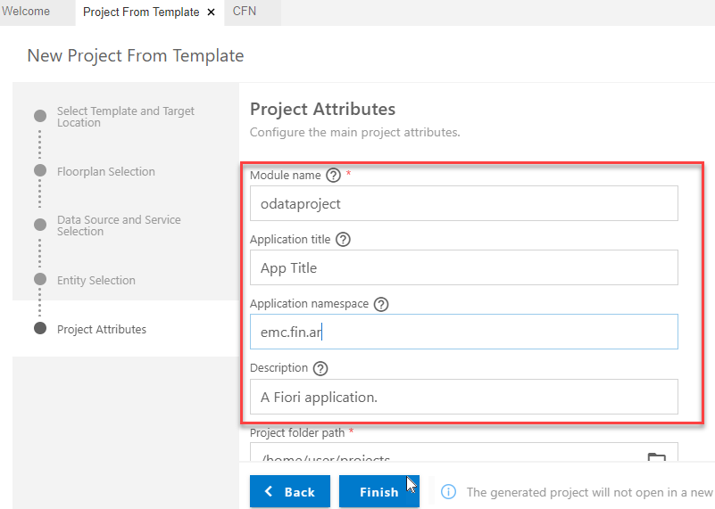
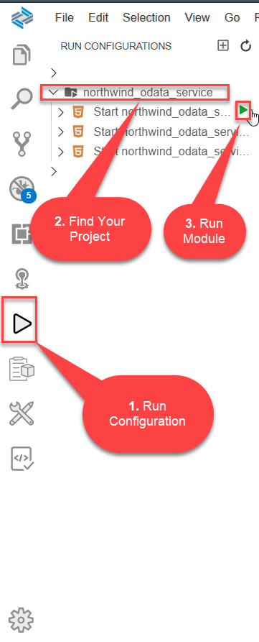
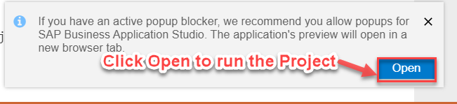
Consuming Custom OData service
Step4: Finalizing the Project
Step5: Run the project from Run Configuration
01
Software Innovation
02
Trainer: Anubhav Oberoy & Shubham Singh

Slide 22
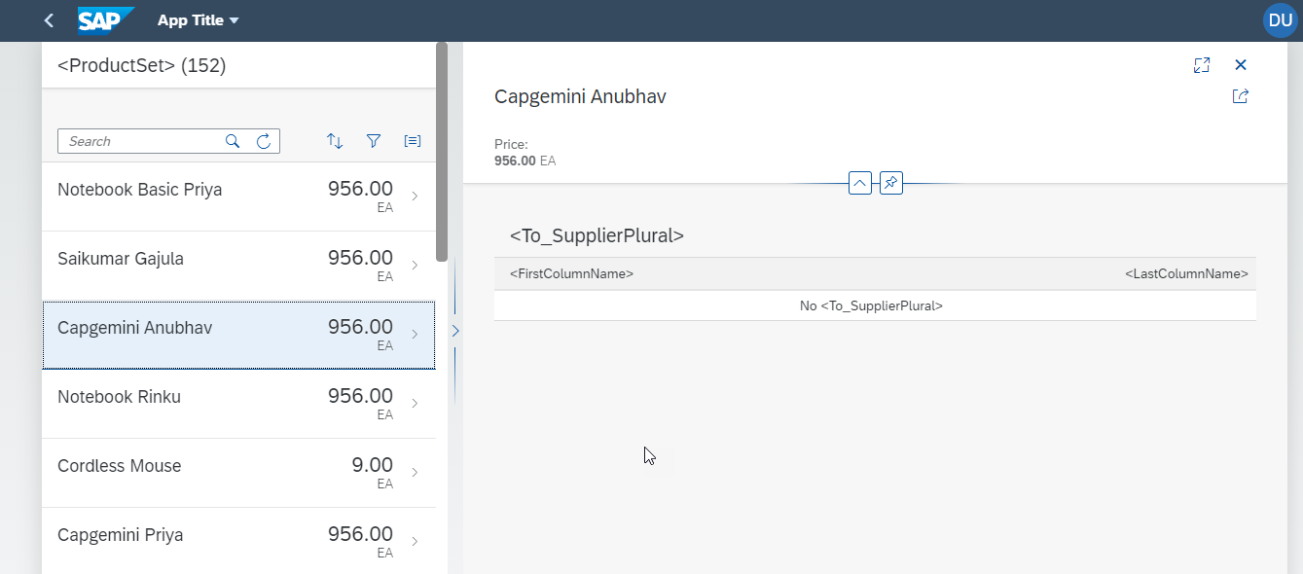
Consuming Custom OData service
Final Project With Custom OData Services
Introduction
01
Software Innovation
02
Hardware Innovation
Trainer: Anubhav Oberoy & Shubham Singh

Slide 23

Summarize
End of Day 6

Slide 24

Questions
Trainer: Anubhav Oberoy & Shubham Singh

Slide 25

ANUBHAV OBEROY
www.anubhavtrainings.com
THANK YOU
“You can never leave footprints that last if you are always walking on tiptoe.”
Notes:
https://pixabay.com/photos/men-employees-suit-work-greeting-1979261/

Slide 26


We’re committed to empower you to be
Most Desirable Resource
through powerful training solutions.
We build the workforce of the future.
250+
Corporate Clients
30,000+
Learners Trained
25000+
Learners Placed
FREE WEBINARS
Sign up for free webinars with industry experts every fortnight!
Enroll Now!
Contact us today!
https://anubhavtrainings.com/

Slide 27




More from AnubhavTrainings.com

